Slide 1
App Description
Oumayma Ben Jemâa

Slide 2
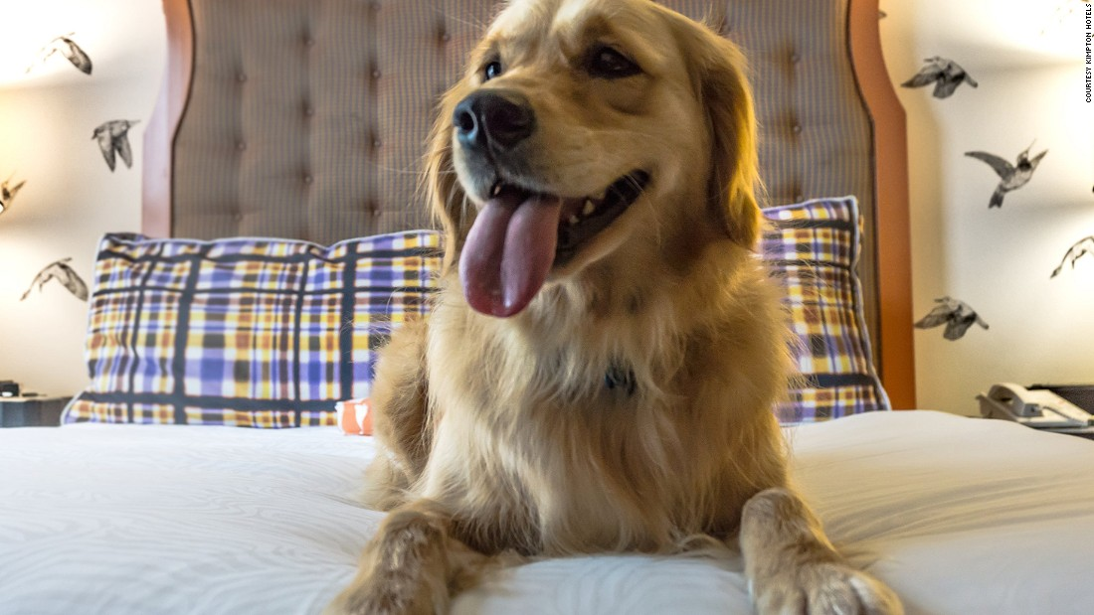
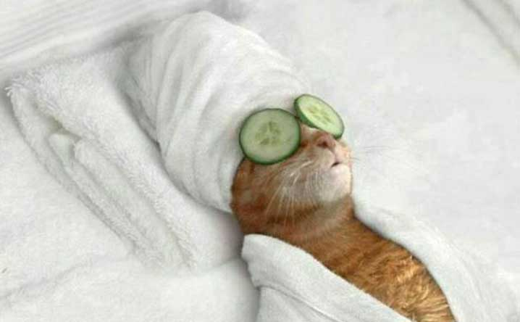

App Topic
My application, is basically an animals hôtel .
So if you have a dog or a cat and you’re opting to travel, have a week-end out, spend a day with your friends and you don’t know where to put youf animal so he can be safe this web site may be usefull and helpfull .

Slide 3
Actors
The main actors are :
1-The admin: who posseds an account and who is responsible of accepting the user’s accounts
2-Users (and here we have two kind of users ) :
a- the user who’s going to recieve the pet
b- the user who’s looking for someone to take care of his pet (which is the user ‘a’)
=> both of them had accounts
3- visitors : are guests who may take a look for few data without posseding an account

Slide 4
Purpose
The purpose here, is to :
1- eiminate the number of abondoned pets
2- encourage people to never hesitate when they need to go and can’t take their pets with them
3- help animal lovers, to win money by doing the thing they like
4- To Make money

